Slide 1
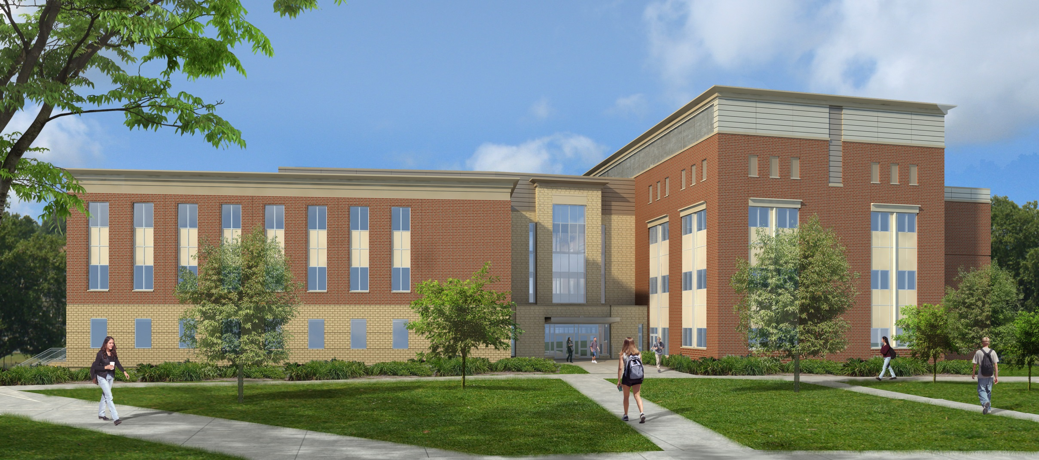
Jeremy Feath
Construction Option
University Engineering Building
Mid-Atlantic University, United States
(Courtesy of Owner)

Slide 2
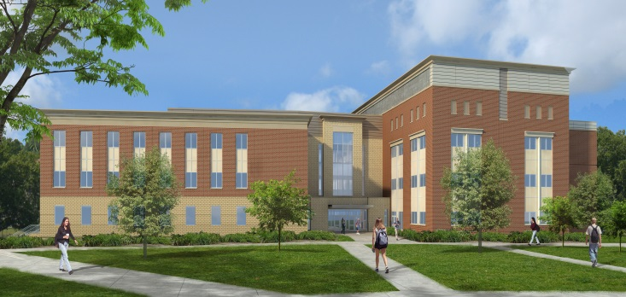
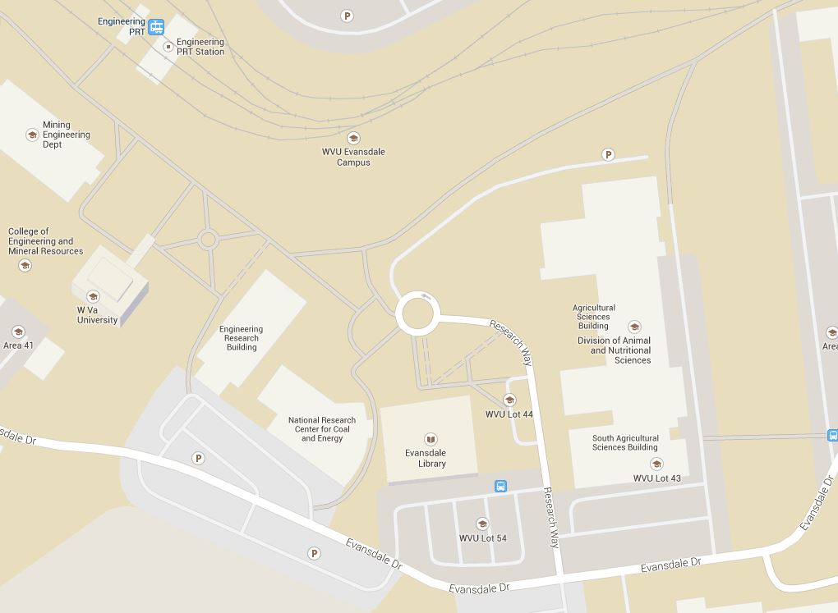
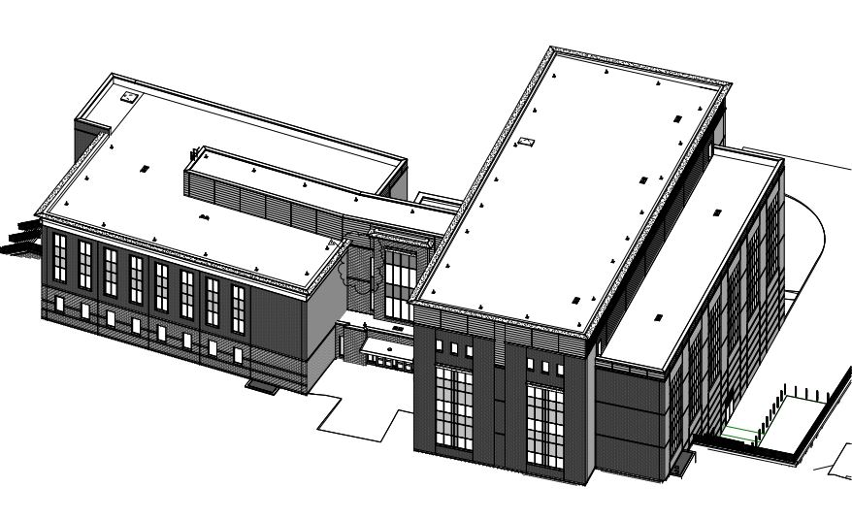
Project Overview
Jeremy Feath
Construction Option
University Engineering Building
Mid-Atlantic University, United States
Project Overview
Analysis 1: Clean Room Coordination
Background
Project Organization Results
Coordination Results
Analysis 2: Roof System Redesign
Background
Schedule Results
Cost Comparison
Structural Breadth
Analysis 3: Underground Spring
Background
Results
Mechanical Breadth
Analysis 4: FM Information Delivery
Final Recommendations
Acknowledgements
Location: Mid-Atlantic, United States
Size: 95,000 SF
Project Cost: $43 million
Delivery Method: Design-Bid-Build
Project Duration: Jan. 2013 – Jan. 2015
(Courtesy of Google Maps)
Owner: Mid-Atlantic University
Design Architect: Stantec Arch. Inc.
General Contractor: Massaro Const.
(Courtesy of Stantec)

Slide 3
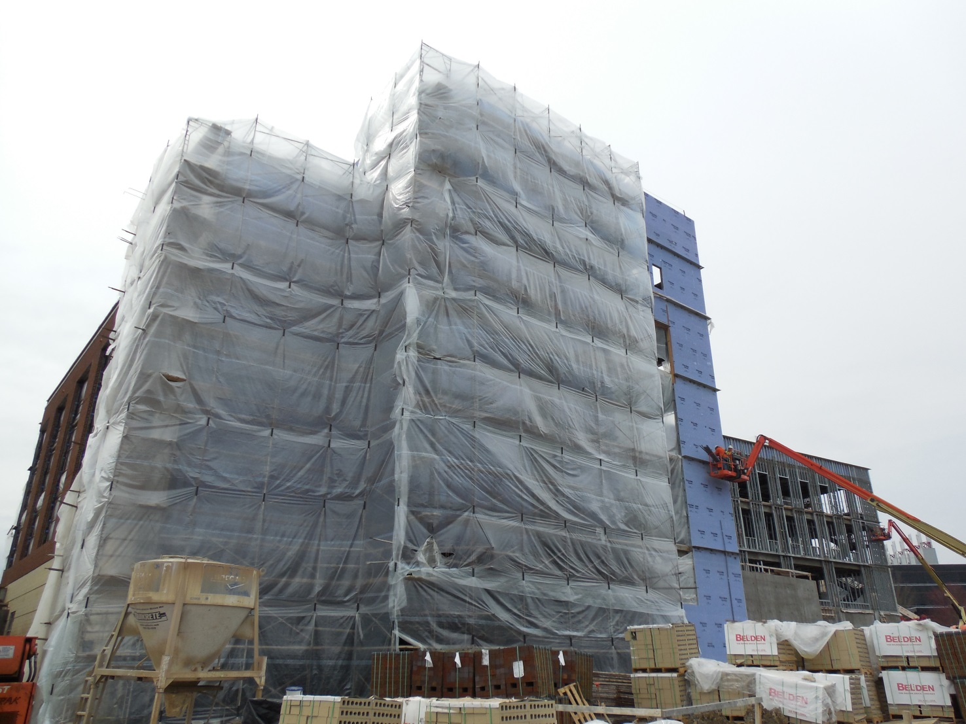
Project Overview
Jeremy Feath
Construction Option
University Engineering Building
Mid-Atlantic University, United States
Project Overview
Analysis 1: Clean Room Coordination
Background
Project Organization Results
Coordination Results
Analysis 2: Roof System Redesign
Background
Schedule Results
Cost Comparison
Structural Breadth
Analysis 3: Underground Spring
Background
Results
Mechanical Breadth
Analysis 4: FM Information Delivery
Final Recommendations
Acknowledgements
Analysis 3: Underground Spring
Propose an alternative to the permanent sump pump to manage the underground spring located underneath the UEB’s foundation
Analysis 4: FM Information Delivery
Research and study the methods of information delivery from CM to FM and utilizing that information to manage facilities
Analysis 1: Clean Room Coordination
Reorganize project organization chart, along with creating and analyzing Clean Room coordination schedule & process
Analysis 2: Roof System Redesign
Propose a feasible alternative to the Fully-Adhered TPO roof system
(Courtesy of Jeremy Feath)

Slide 4
Analysis 1
Jeremy Feath
Construction Option
University Engineering Building
Mid-Atlantic University, United States
Project Overview
Analysis 1: Clean Room Coordination
Background
Project Organization Results
Coordination Results
Analysis 2: Roof System Redesign
Background
Schedule Results
Cost Comparison
Structural Breadth
Analysis 3: Underground Spring
Background
Results
Mechanical Breadth
Analysis 4: FM Information Delivery
Final Recommendations
Acknowledgements
Analysis 1:
Clean Room Coordination

Slide 5
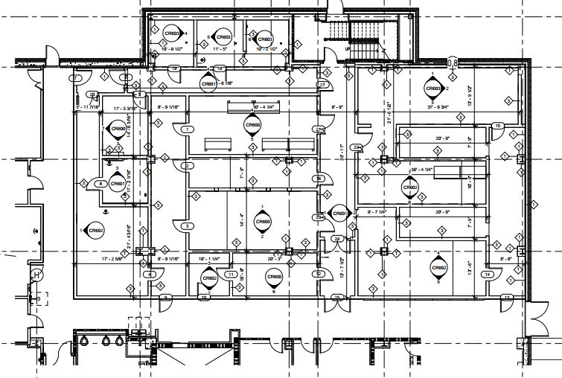
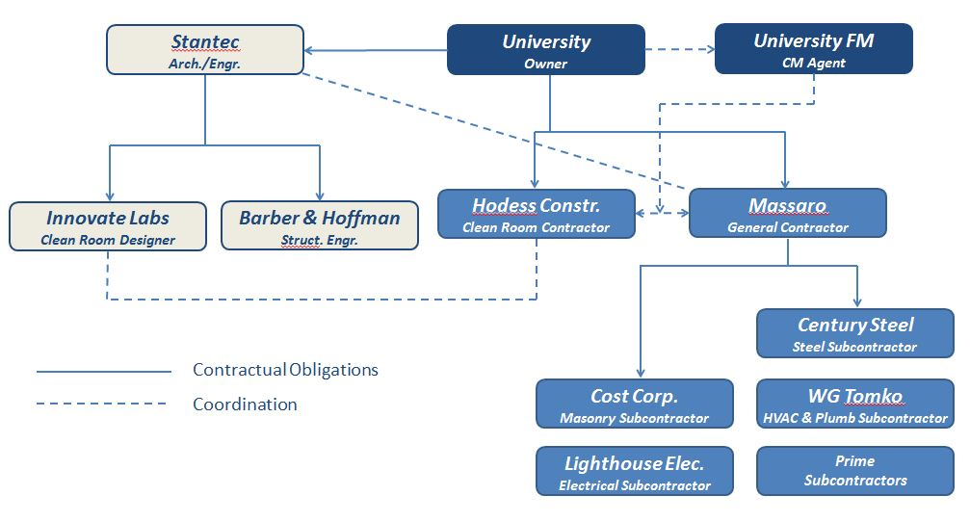
Analysis 1
Clean Room Coordination
Background
University Engineering Building
Mid-Atlantic University, United States
Project Overview
Analysis 1: Clean Room Coordination
Background
Project Organization Results
Coordination Results
Analysis 2: Roof System Redesign
Background
Schedule Results
Cost Comparison
Structural Breadth
Analysis 3: Underground Spring
Background
Results
Mechanical Breadth
Analysis 4: FM Information Delivery
Final Recommendations
Acknowledgements
(Courtesy of Stantec)
Problem Identification:
Both Massaro and Hodess have separate contracts w/ the Owner
Coordination for the Clean Room is extremely intensive
Scopes of Work
Constructability
(Courtesy of Jeremy Feath)
(Courtesy of Stantec)

Slide 6
Analysis 1
Clean Room Coordination
Project Organization
University Engineering Building
Mid-Atlantic University, United States
Project Overview
Analysis 1: Clean Room Coordination
Background
Project Organization Results
Coordination Results
Analysis 2: Roof System Redesign
Background
Schedule Results
Cost Comparison
Structural Breadth
Analysis 3: Underground Spring
Background
Results
Mechanical Breadth
Analysis 4: FM Information Delivery
Final Recommendations
Acknowledgements
Original Contractual Obligations:
Hodess used for Design Coordination, contracted to Owner at time
Massaro chosen as General Contractor, contracted to Owner
Owner unsuccessfully attempted to transfer Hodess’ contract to Massaro
Original Design-Bid-Build
Hodess contract w/ Owner
(Courtesy of Jeremy Feath)

Slide 7
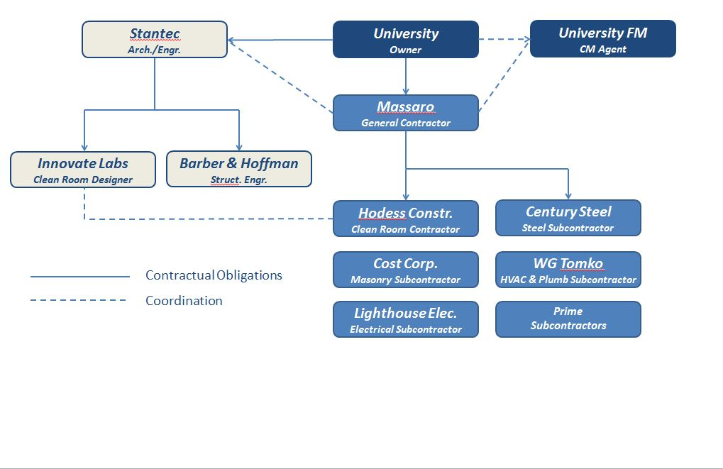
Project Overview
Jeremy Feath
Construction Option
Project Organization
Analysis 1
Clean Room Coordination
University Engineering Building
Mid-Atlantic University, United States
University Engineering Building
Mid-Atlantic University, United States
Project Overview
Analysis 1: Clean Room Coordination
Analysis 2: Roof System Redesign
Analysis 3: Underground Spring
Analysis 4: FM Information Delivery
Final Recommendations
Acknowledgements
Project Overview
Analysis 1: Clean Room Coordination
Background
Project Organization Results
Coordination Results
Analysis 2: Roof System Redesign
Background
Schedule Results
Cost Comparison
Structural Breadth
Analysis 3: Underground Spring
Background
Results
Mechanical Breadth
Analysis 4: FM Information Delivery
Final Recommendations
Acknowledgements
Original Contractual Obligations:
Hodess used for Design Coordination, contracted to Owner at time
Massaro chosen as General Contractor, contracted to Owner
Owner unsuccessfully attempted to transfer Hodess’ contract to Massaro
New Contractual Obligations:
Hodess has preconstruction contract with Owner
Massaro awarded bid, contract with the Owner
Hodess now acts as a subcontractor, construction contract with Massaro
Original Design-Bid-Build
Hodess contract w/ Owner
New Design-Bid-Build
Hodess contract w/ Massaro
(Courtesy of Jeremy Feath)
(Courtesy of Jeremy Feath)

Slide 8
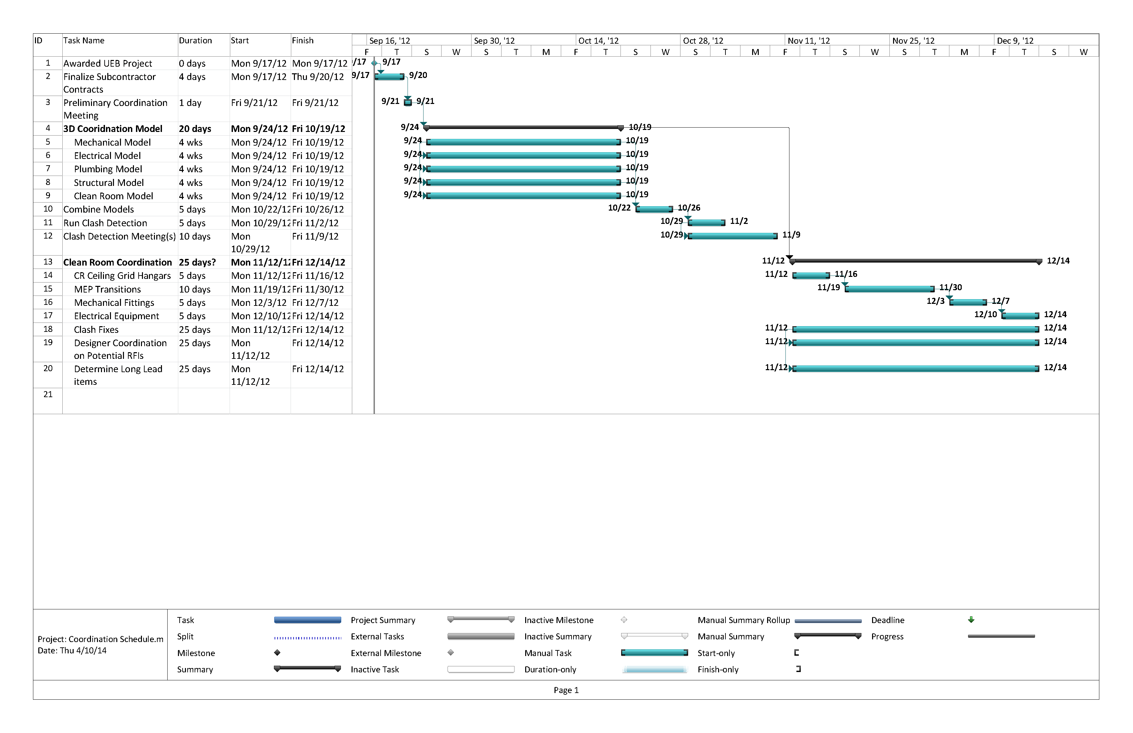
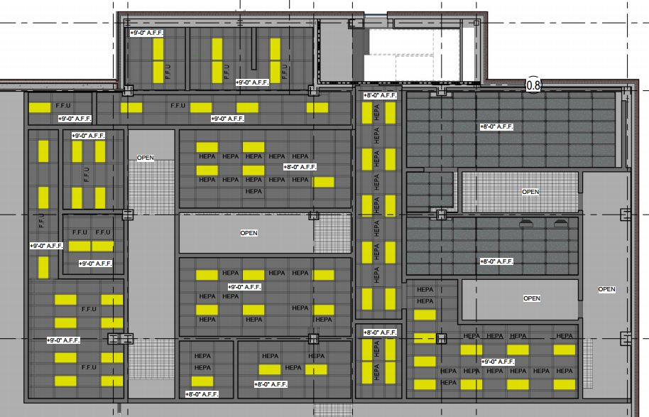
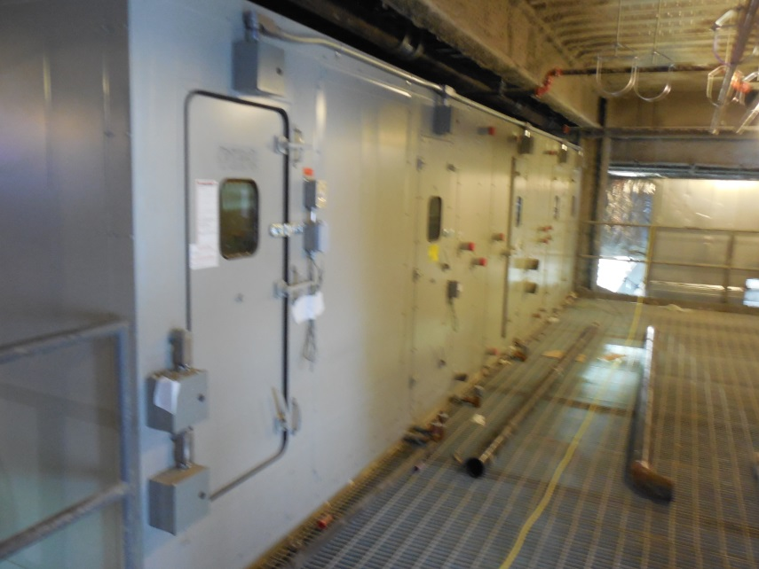
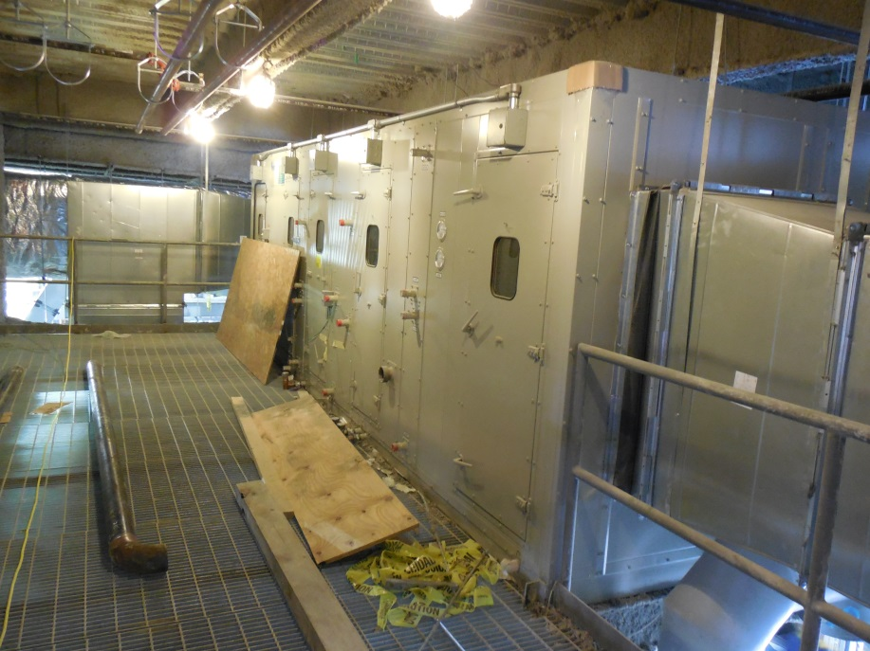
Project Overview
Jeremy Feath
Construction Option
Clean Room Coordination
Analysis 1
Clean Room Coordination
University Engineering Building
Mid-Atlantic University, United States
University Engineering Building
Mid-Atlantic University, United States
Project Overview
Analysis 1: Clean Room Coordination
Analysis 2: Roof System Redesign
Analysis 3: Underground Spring
Analysis 4: FM Information Delivery
Final Recommendations
Acknowledgements
Project Overview
Analysis 1: Clean Room Coordination
Background
Project Organization Results
Coordination Results
Analysis 2: Roof System Redesign
Background
Schedule Results
Cost Comparison
Structural Breadth
Analysis 3: Underground Spring
Background
Results
Mechanical Breadth
Analysis 4: FM Information Delivery
Final Recommendations
Acknowledgements
Problem Areas:
Clean Room Light Fixtures
Mezzanine AHUs
Clean Room Ceiling Grid
(Courtesy of Jeremy Feath)
(Courtesy of Jeremy Feath)
(Courtesy of Jeremy Feath)
(Courtesy of Stantec)

Slide 9
Project Overview
Jeremy Feath
Construction Option
Clean Room Coordination
Analysis 1
Clean Room Coordination
University Engineering Building
Mid-Atlantic University, United States
University Engineering Building
Mid-Atlantic University, United States
Project Overview
Analysis 1: Clean Room Coordination
Analysis 2: Roof System Redesign
Analysis 3: Underground Spring
Analysis 4: FM Information Delivery
Final Recommendations
Acknowledgements
Project Overview
Analysis 1: Clean Room Coordination
Background
Project Organization Results
Coordination Results
Analysis 2: Roof System Redesign
Background
Schedule Results
Cost Comparison
Structural Breadth
Analysis 3: Underground Spring
Background
Results
Mechanical Breadth
Analysis 4: FM Information Delivery
Final Recommendations
Acknowledgements
Problem Areas:
Clean Room Light Fixtures
Mezzanine AHUs
Clean Room Ceiling Grid
Tools:
3D Model Coordination
Hodess Precon experience
Early Problem Identification
Savings:
Less RFIs, COs
Fewer Constructability Problems
Potential Schedule Savings
(Courtesy of Jeremy Feath)
(Courtesy of Jeremy Feath)
(Courtesy of Jeremy Feath)
(Courtesy of Stantec)

Slide 10
Project Overview
Jeremy Feath
Construction Option
Analysis 2
University Engineering Building
Mid-Atlantic University, United States
Jeremy Feath
Construction Option
University Engineering Building
Mid-Atlantic University, United States
Project Overview
Analysis 1: Clean Room Coordination
Analysis 2: Roof System Redesign
Analysis 3: Underground Spring
Analysis 4: FM Information Delivery
Final Recommendations
Acknowledgements
Project Overview
Analysis 1: Clean Room Coordination
Background
Project Organization Results
Coordination Results
Analysis 2: Roof System Redesign
Background
Schedule Results
Cost Comparison
Structural Breadth
Analysis 3: Underground Spring
Background
Results
Mechanical Breadth
Analysis 4: FM Information Delivery
Final Recommendations
Acknowledgements
Analysis 2:
Roof System Redesign

Slide 11
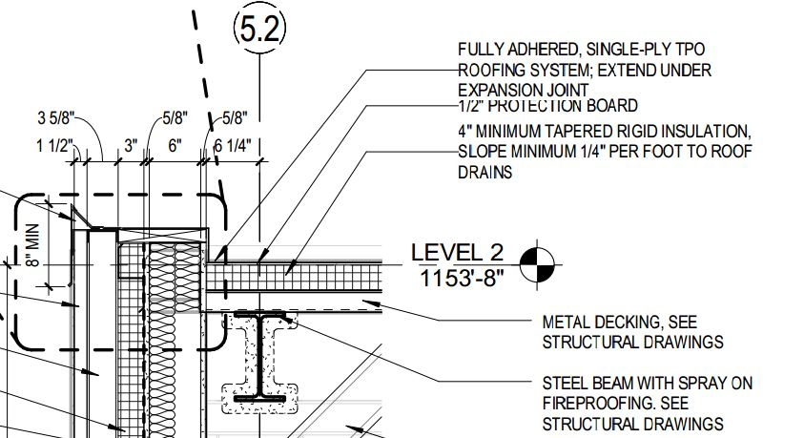
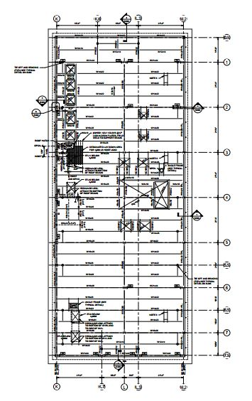
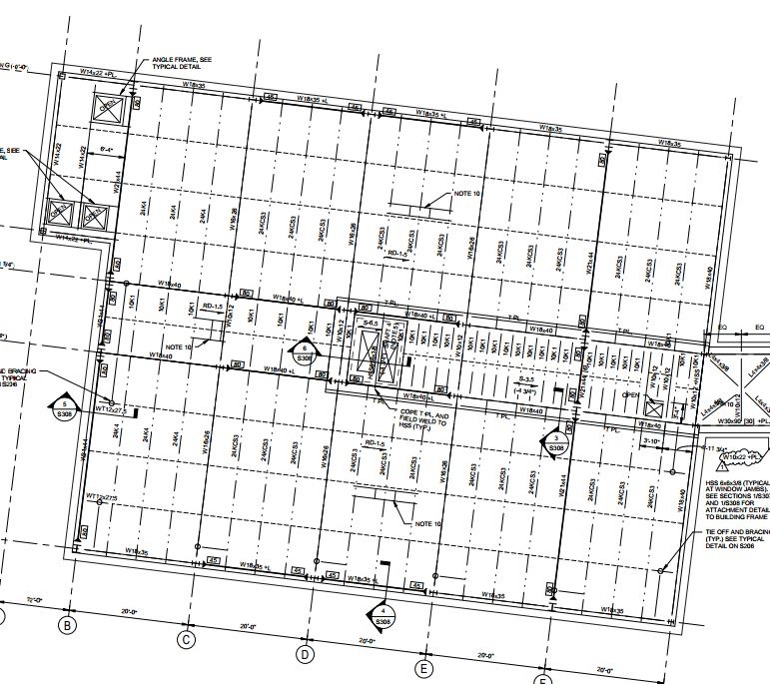
Project Overview
Jeremy Feath
Construction Option
Background
Analysis 2
Roof System Redesign
University Engineering Building
Mid-Atlantic University, United States
University Engineering Building
Mid-Atlantic University, United States
Project Overview
Analysis 1: Clean Room Coordination
Analysis 2: Roof System Redesign
Analysis 3: Underground Spring
Analysis 4: FM Information Delivery
Final Recommendations
Acknowledgements
Project Overview
Analysis 1: Clean Room Coordination
Background
Project Organization Results
Coordination Results
Analysis 2: Roof System Redesign
Background
Schedule Results
Cost Comparison
Structural Breadth
Analysis 3: Underground Spring
Background
Results
Mechanical Breadth
Analysis 4: FM Information Delivery
Final Recommendations
Acknowledgements
(Courtesy of Stantec)
Lab Roof: 14,000 SF
Office Roof: 10,000 SF

Slide 12
Project Overview
Jeremy Feath
Construction Option
Background
Analysis 2
Roof System Redesign
University Engineering Building
Mid-Atlantic University, United States
University Engineering Building
Mid-Atlantic University, United States
Project Overview
Analysis 1: Clean Room Coordination
Analysis 2: Roof System Redesign
Analysis 3: Underground Spring
Analysis 4: FM Information Delivery
Final Recommendations
Acknowledgements
Project Overview
Analysis 1: Clean Room Coordination
Background
Project Organization Results
Coordination Results
Analysis 2: Roof System Redesign
Background
Schedule Results
Cost Comparison
Structural Breadth
Analysis 3: Underground Spring
Background
Results
Mechanical Breadth
Analysis 4: FM Information Delivery
Final Recommendations
Acknowledgements
Original Project Schedule
(Courtesy of Stantec)
Lab Roof Activities – Total Duration: 61 days
Lab Roof: 14,000 SF
Office Roof: 10,000 SF
Office Roof Activities – Total Duration: 30 days
(Courtesy of Massaro)

Slide 13
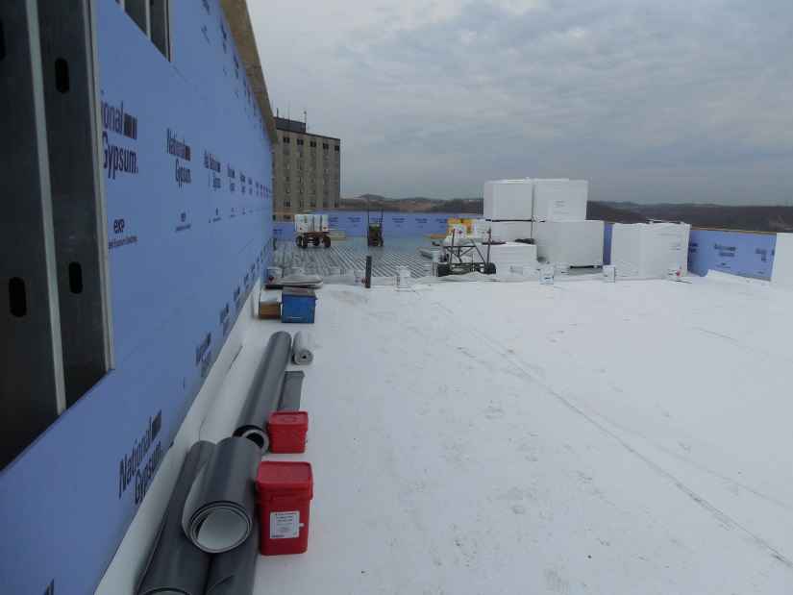
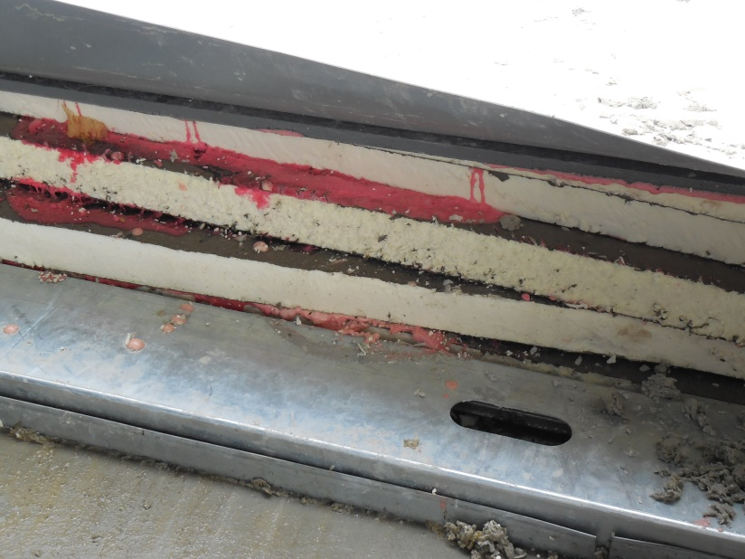
Project Overview
Jeremy Feath
Construction Option
Background
Analysis 2
Roof System Redesign
University Engineering Building
Mid-Atlantic University, United States
University Engineering Building
Mid-Atlantic University, United States
Project Overview
Analysis 1: Clean Room Coordination
Analysis 2: Roof System Redesign
Analysis 3: Underground Spring
Analysis 4: FM Information Delivery
Final Recommendations
Acknowledgements
Project Overview
Analysis 1: Clean Room Coordination
Background
Project Organization Results
Coordination Results
Analysis 2: Roof System Redesign
Background
Schedule Results
Cost Comparison
Structural Breadth
Analysis 3: Underground Spring
Background
Results
Mechanical Breadth
Analysis 4: FM Information Delivery
Final Recommendations
Acknowledgements
Roof System Problems:
Cold-Weather Constructability Difficult
Increased General Conditions Costs
Delayed Interior Work (Fireproofing, MEP Rough-Ins)
Original Project Schedule
(Courtesy of Stantec)
Lab Roof Activities – Total Duration: 61 days
Lab Roof: 14,000 SF
Office Roof: 10,000 SF
Office Roof Activities – Total Duration: 30 days
(Courtesy of Massaro)
(Courtesy of Jeremy Feath)
(Courtesy of Jeremy Feath)

Slide 14
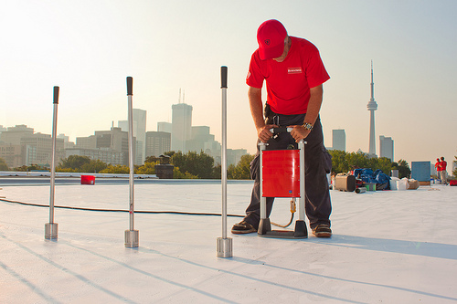
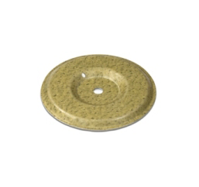
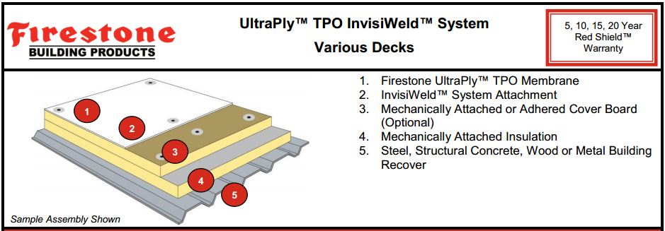
Project Overview
Jeremy Feath
Construction Option
Background
Analysis 2
Roof System Redesign
University Engineering Building
Mid-Atlantic University, United States
University Engineering Building
Mid-Atlantic University, United States
Project Overview
Analysis 1: Clean Room Coordination
Analysis 2: Roof System Redesign
Analysis 3: Underground Spring
Analysis 4: FM Information Delivery
Final Recommendations
Acknowledgements
Project Overview
Analysis 1: Clean Room Coordination
Background
Project Organization Results
Coordination Results
Analysis 2: Roof System Redesign
Background
Schedule Results
Cost Comparison
Structural Breadth
Analysis 3: Underground Spring
Background
Results
Mechanical Breadth
Analysis 4: FM Information Delivery
Final Recommendations
Acknowledgements
Proposed Solution:
Firestone TPO InvisiWeld System
Improved Cold-Weather Constructability
Meets Owner Approval & Contractor Experience
(Courtesy of Firestone Building Products)
(Courtesy of Firestone Building Products)

Slide 15
Project Overview
Jeremy Feath
Construction Option
Schedule Results
Analysis 2
Roof System Redesign
University Engineering Building
Mid-Atlantic University, United States
University Engineering Building
Mid-Atlantic University, United States
Project Overview
Analysis 1: Clean Room Coordination
Analysis 2: Roof System Redesign
Analysis 3: Underground Spring
Analysis 4: FM Information Delivery
Final Recommendations
Acknowledgements
Project Overview
Analysis 1: Clean Room Coordination
Background
Project Organization Results
Coordination Results
Analysis 2: Roof System Redesign
Background
Schedule Results
Cost Comparison
Structural Breadth
Analysis 3: Underground Spring
Background
Results
Mechanical Breadth
Analysis 4: FM Information Delivery
Final Recommendations
Acknowledgements
InvisiWeld Plate Weld Durations
Location | Area (SF) | 4'x8' Board (SF) | # Boards | Avg. # of Plates | Total Plates | # Plates/Hr. | Total Hrs. | Total Days
Lab | 14000 | 32 | 437.5 | 14 | 6125 | 300 | 20.42 | 2.55
Office | 10000 | 32 | 312.5 | 14 | 4375 | 300 | 14.58 | 1.82
Note: 300 plates/hr. based on Firestone literature
Roof System Duration Comparison
Roof System | Lab Duration | Office Duration | Total Duration
Fully-Adhered TPO | 61 | 30 | 61
InvisiWeld | 35 | 25 | 40
Built-Up Roof | 51 | 47 | 65
(All Courtesy of Jeremy Feath)

Slide 16
Project Overview
Jeremy Feath
Construction Option
Schedule Results
Analysis 2
Roof System Redesign
University Engineering Building
Mid-Atlantic University, United States
University Engineering Building
Mid-Atlantic University, United States
Project Overview
Analysis 1: Clean Room Coordination
Analysis 2: Roof System Redesign
Analysis 3: Underground Spring
Analysis 4: FM Information Delivery
Final Recommendations
Acknowledgements
Project Overview
Analysis 1: Clean Room Coordination
Background
Project Organization Results
Coordination Results
Analysis 2: Roof System Redesign
Background
Schedule Results
Cost Comparison
Structural Breadth
Analysis 3: Underground Spring
Background
Results
Mechanical Breadth
Analysis 4: FM Information Delivery
Final Recommendations
Acknowledgements
InvisiWeld Plate Weld Durations
Location | Area (SF) | 4'x8' Board (SF) | # Boards | Avg. # of Plates | Total Plates | # Plates/Hr. | Total Hrs. | Total Days
Lab | 14000 | 32 | 437.5 | 14 | 6125 | 300 | 20.42 | 2.55
Office | 10000 | 32 | 312.5 | 14 | 4375 | 300 | 14.58 | 1.82
InvisiWeld Construction Schedule
Note: 300 plates/hr. based on Firestone literature
Roof System Duration Comparison
Roof System | Lab Duration | Office Duration | Total Duration
Fully-Adhered TPO | 61 | 30 | 61
InvisiWeld | 35 | 25 | 40
Built-Up Roof | 51 | 47 | 65
(All Courtesy of Jeremy Feath)

Slide 17
Project Overview
Jeremy Feath
Construction Option
Cost Comparison
Analysis 2
Roof System Redesign
University Engineering Building
Mid-Atlantic University, United States
University Engineering Building
Mid-Atlantic University, United States
Project Overview
Analysis 1: Clean Room Coordination
Analysis 2: Roof System Redesign
Analysis 3: Underground Spring
Analysis 4: FM Information Delivery
Final Recommendations
Acknowledgements
Project Overview
Analysis 1: Clean Room Coordination
Background
Project Organization Results
Coordination Results
Analysis 2: Roof System Redesign
Background
Schedule Results
Cost Comparison
Structural Breadth
Analysis 3: Underground Spring
Background
Results
Mechanical Breadth
Analysis 4: FM Information Delivery
Final Recommendations
Acknowledgements
Fully Adhered TPO Membrane Roof Estimate
Material | Quantity | Unit | Cost/Unit | Total Cost
TPO Membrane (80 mil) | 24000 | SF | $1.03 | $24,720.00
Multipurpose Adhesives | 40 | 600 SF | $145.00 | $5,800.00
Expansion Joint | 800 | LF | $2.00 | $1,600.00
1/2" Protection Board | 24000 | SF | $0.53 | $12,720.00
(2) 2" Rigid Insulation | 24000 | SF | $0.65 | $15,600.00
Single-Ply Memb. Sealants | 100 | 1 gal. Pail | $75.00 | $7,500.00
Sealant Primers | 100 | 1 gal. Pail | $67.00 | $6,700.00
Sheet Flashing | 24 | 100 SF | $251.00 | $6,024.00
Bonding Adhesive | 54 | 450 SF Pail | $145.00 | $7,830.00
Fasteners | 25 | 5" HD 1000/Pail | $190.00 | $4,750.00
Metal Termination Bar | 80 | 10 LF | $7.00 | $560.00
Total |  |  |  | $93,804.00
Original General Conditions Estimate
Increase in Temporary Heating & Enclosure:
Protect Penthouse Equipment & Stored Materials
Enable interior rough-in work to continue
TOTAL |  |  | $1,610,845.00
TOTAL CONSTRUCTION COSTS * 6% |  |  | $1,962,000.00
COST DIFFERENCE |  |  | $351,155.00
% DIFFERENCE |  |  | 17.90
Revised General Conditions Estimate
TOTAL |  |  | $1,618,545.00
TOTAL CONSTRUCTION COSTS * 6% |  |  | $1,962,000.00
COST DIFFERENCE |  |  | $343,455.00
% DIFFERENCE |  |  | 17.51
Note: The increase in GC does not occur for BUR or InvisiWeld
Fully-Adhered TPO System
General Conditions Increase - $7,700
(All Courtesy of Jeremy Feath)

Slide 18
Project Overview
Jeremy Feath
Construction Option
Cost Comparison
Analysis 2
Roof System Redesign
University Engineering Building
Mid-Atlantic University, United States
University Engineering Building
Mid-Atlantic University, United States
Project Overview
Analysis 1: Clean Room Coordination
Analysis 2: Roof System Redesign
Analysis 3: Underground Spring
Analysis 4: FM Information Delivery
Final Recommendations
Acknowledgements
Project Overview
Analysis 1: Clean Room Coordination
Background
Project Organization Results
Coordination Results
Analysis 2: Roof System Redesign
Background
Schedule Results
Cost Comparison
Structural Breadth
Analysis 3: Underground Spring
Background
Results
Mechanical Breadth
Analysis 4: FM Information Delivery
Final Recommendations
Acknowledgements
Fully Adhered TPO Membrane Roof Estimate
Material | Quantity | Unit | Cost/Unit | Total Cost
TPO Membrane (80 mil) | 24000 | SF | $1.03 | $24,720.00
Multipurpose Adhesives | 40 | 600 SF | $145.00 | $5,800.00
Expansion Joint | 800 | LF | $2.00 | $1,600.00
1/2" Protection Board | 24000 | SF | $0.53 | $12,720.00
(2) 2" Rigid Insulation | 24000 | SF | $0.65 | $15,600.00
Single-Ply Memb. Sealants | 100 | 1 gal. Pail | $75.00 | $7,500.00
Sealant Primers | 100 | 1 gal. Pail | $67.00 | $6,700.00
Sheet Flashing | 24 | 100 SF | $251.00 | $6,024.00
Bonding Adhesive | 54 | 450 SF Pail | $145.00 | $7,830.00
Fasteners | 25 | 5" HD 1000/Pail | $190.00 | $4,750.00
Metal Termination Bar | 80 | 10 LF | $7.00 | $560.00
Total |  |  |  | $93,804.00
Traditional Built-Up Roof
Material | Quantity | Unit | Cost/Unit | Total Cost
Ply VI Membrane (4 Layers) | 96000 | SF (1 - Layer) | $0.85 | $81,600.00
Asphalt | 30 | ton | $820.00 | $24,600.00
(2) 2" Rigid Insulation | 24000 | SF | $0.65 | $15,600.00
Cover Board | 24000 | SF | $0.53 | $12,720.00
Total |  |  |  | $134,520.00
Labor Cost Estimate
Roof Type | Duration (days) | Hourly Rate | Daily Rate | Total Cost
Fully-Adhered TPO | 61 | $100.00 | $800.00 | $48,800.00
Built-Up Roof | 65 | $100.00 | $800.00 | $52,000.00
InvisiWeld TPO | 40 | $100.00 | $800.00 | $32,000.00
(All Courtesy of Jeremy Feath)

Slide 19
Project Overview
Jeremy Feath
Construction Option
Cost Comparison
Analysis 2
Roof System Redesign
University Engineering Building
Mid-Atlantic University, United States
University Engineering Building
Mid-Atlantic University, United States
Project Overview
Analysis 1: Clean Room Coordination
Analysis 2: Roof System Redesign
Analysis 3: Underground Spring
Analysis 4: FM Information Delivery
Final Recommendations
Acknowledgements
Project Overview
Analysis 1: Clean Room Coordination
Background
Project Organization Results
Coordination Results
Analysis 2: Roof System Redesign
Background
Schedule Results
Cost Comparison
Structural Breadth
Analysis 3: Underground Spring
Background
Results
Mechanical Breadth
Analysis 4: FM Information Delivery
Final Recommendations
Acknowledgements
Fully Adhered TPO Membrane Roof Estimate
Material | Quantity | Unit | Cost/Unit | Total Cost
TPO Membrane (80 mil) | 24000 | SF | $1.03 | $24,720.00
Multipurpose Adhesives | 40 | 600 SF | $145.00 | $5,800.00
Expansion Joint | 800 | LF | $2.00 | $1,600.00
1/2" Protection Board | 24000 | SF | $0.53 | $12,720.00
(2) 2" Rigid Insulation | 24000 | SF | $0.65 | $15,600.00
Single-Ply Memb. Sealants | 100 | 1 gal. Pail | $75.00 | $7,500.00
Sealant Primers | 100 | 1 gal. Pail | $67.00 | $6,700.00
Sheet Flashing | 24 | 100 SF | $251.00 | $6,024.00
Bonding Adhesive | 54 | 450 SF Pail | $145.00 | $7,830.00
Fasteners | 25 | 5" HD 1000/Pail | $190.00 | $4,750.00
Metal Termination Bar | 80 | 10 LF | $7.00 | $560.00
Total |  |  |  | $93,804.00
Traditional Built-Up Roof
Material | Quantity | Unit | Cost/Unit | Total Cost
Ply VI Membrane (4 Layers) | 96000 | SF (1 - Layer) | $0.85 | $81,600.00
Asphalt | 30 | ton | $820.00 | $24,600.00
(2) 2" Rigid Insulation | 24000 | SF | $0.65 | $15,600.00
Cover Board | 24000 | SF | $0.53 | $12,720.00
Total |  |  |  | $134,520.00
InvisiWeld TPO Membrane Roof
Material | Quantity | Unit | Cost/Unit | Total Cost
TPO Membrane (80 mil) | 24000 | SF | $1.03 | $24,720.00
Expansion Joint | 800 | LF | $2.00 | $1,600.00
1/2" Protection Board | 24000 | SF | $0.53 | $12,720.00
(2) 2" Rigid Insulation | 24000 | SF | $0.65 | $15,600.00
Single-Ply Memb. Sealants | 100 | 1 gal. Pail | $75.00 | $7,500.00
Sealant Primers | 100 | 1 gal. Pail | $67.00 | $6,700.00
Sheet Flashing | 24 | 100 SF | $251.00 | $6,024.00
Fasteners | 25 | 5" HD 1000/Pail | $190.00 | $4,750.00
InvisiWeld Plates | 21 | 500 Pail | $90.00 | $1,890.00
InvisiWeld Machine | 1 | EA | $7,500.00 | $7,500.00
T-Patches | 5250 | EA | $0.44 | $2,310.00
Pipe Boots | 10 | EA | $23.00 | $230.00
Total |  |  |  | $91,544.00
Total Cost Savings:
$26,760.00
Labor Cost Estimate
Roof Type | Duration (days) | Hourly Rate | Daily Rate | Total Cost
Fully-Adhered TPO | 61 | $100.00 | $800.00 | $48,800.00
Built-Up Roof | 65 | $100.00 | $800.00 | $52,000.00
InvisiWeld TPO | 40 | $100.00 | $800.00 | $32,000.00
(All Courtesy of Jeremy Feath)

Slide 20
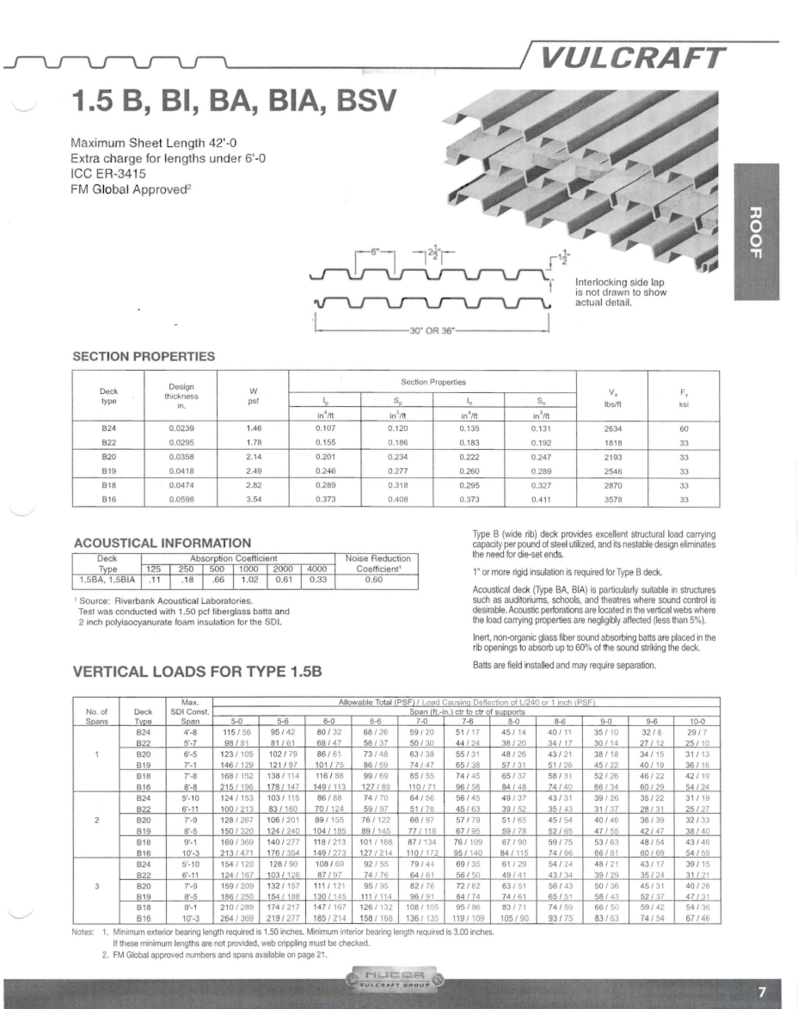
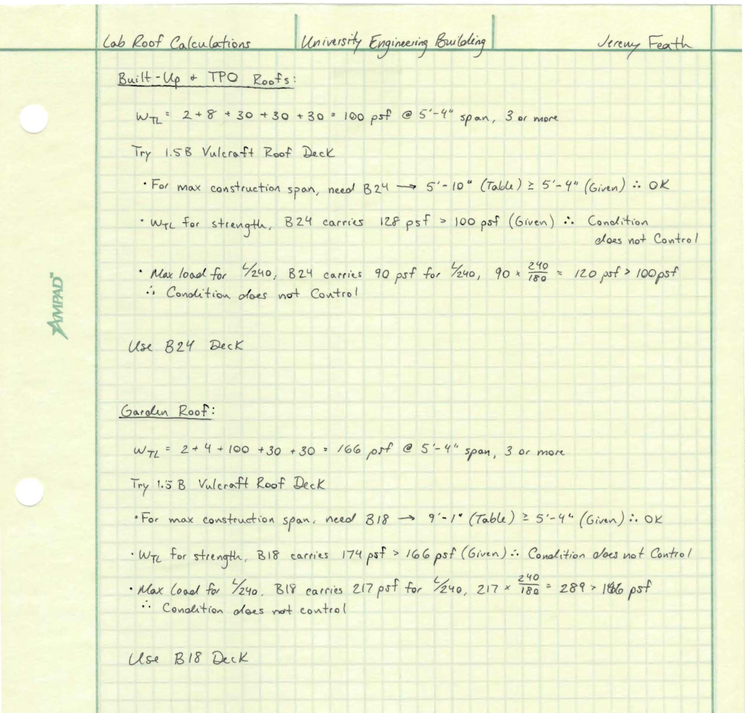
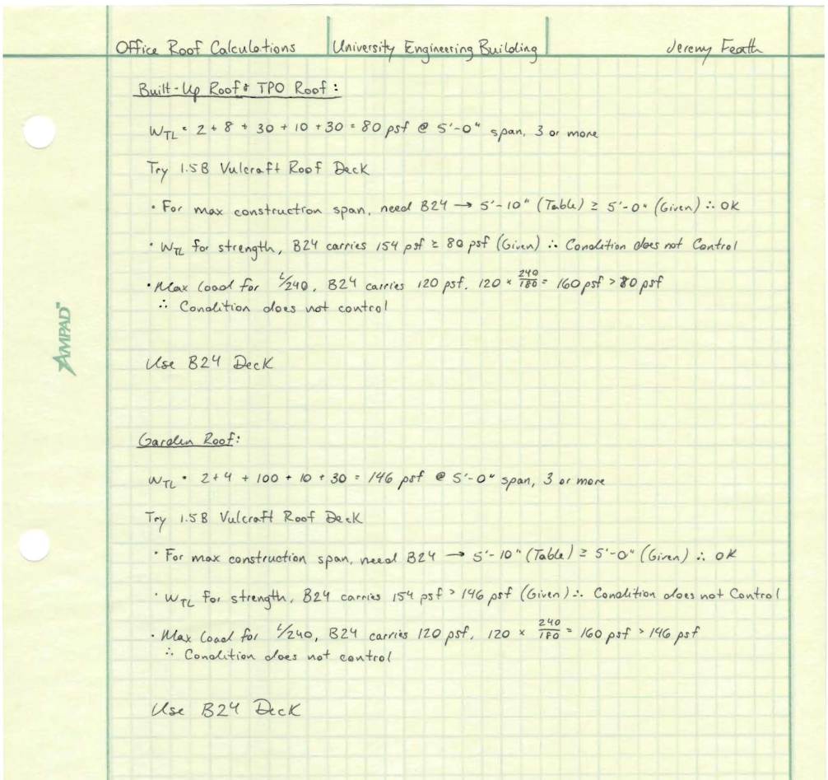
Analysis 2
Roof System Redesign
Roof Deck Study
University Engineering Building
Mid-Atlantic University, United States
Project Overview
Analysis 1: Clean Room Coordination
Background
Project Organization Results
Coordination Results
Analysis 2: Roof System Redesign
Background
Schedule Results
Cost Comparison
Structural Breadth
Analysis 3: Underground Spring
Background
Results
Mechanical Breadth
Analysis 4: FM Information Delivery
Final Recommendations
Acknowledgements
Purpose:
To study the affect increased roof load has on metal decking
(Courtesy of Vulcraft)
TPO vs. Garden Roof
Original Deck: 1-1/2”, 20 gauge
(Courtesy of Stantec)
(Courtesy of Jeremy Feath)

Slide 21
Project Overview
Jeremy Feath
Construction Option
Analysis 3
University Engineering Building
Mid-Atlantic University, United States
Jeremy Feath
Construction Option
University Engineering Building
Mid-Atlantic University, United States
Project Overview
Analysis 1: Clean Room Coordination
Analysis 2: Roof System Redesign
Analysis 3: Underground Spring
Analysis 4: FM Information Delivery
Final Recommendations
Acknowledgements
Project Overview
Analysis 1: Clean Room Coordination
Background
Project Organization Results
Coordination Results
Analysis 2: Roof System Redesign
Background
Schedule Results
Cost Comparison
Structural Breadth
Analysis 3: Underground Spring
Background
Results
Mechanical Breadth
Analysis 4: FM Information Delivery
Final Recommendations
Acknowledgements
Analysis 3:
Underground Spring

Slide 22
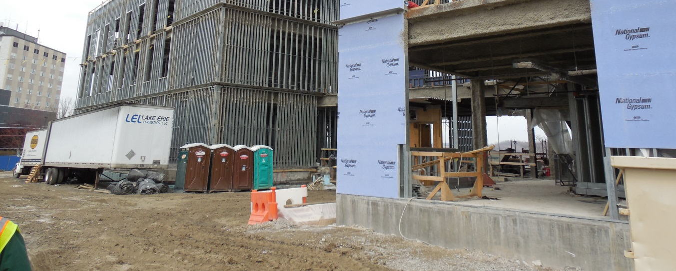
Project Overview
Jeremy Feath
Construction Option
Background
Analysis 3
Underground Spring
University Engineering Building
Mid-Atlantic University, United States
University Engineering Building
Mid-Atlantic University, United States
Project Overview
Analysis 1: Clean Room Coordination
Analysis 2: Roof System Redesign
Analysis 3: Underground Spring
Analysis 4: FM Information Delivery
Final Recommendations
Acknowledgements
Project Overview
Analysis 1: Clean Room Coordination
Background
Project Organization Results
Coordination Results
Analysis 2: Roof System Redesign
Background
Schedule Results
Cost Comparison
Structural Breadth
Analysis 3: Underground Spring
Background
Results
Mechanical Breadth
Analysis 4: FM Information Delivery
Final Recommendations
Acknowledgements
Problems:
Spring & Rain delayed construction during Excavation & Foundations
Spring was NOT discovered during GeoTech Investigation
Proposed Solution:
Addition of Waterproofing Membrane to Lab Foundation Wall w/ Sump Pump backup
(Courtesy of Jeremy Feath)
(Courtesy of Stantec)

Slide 23
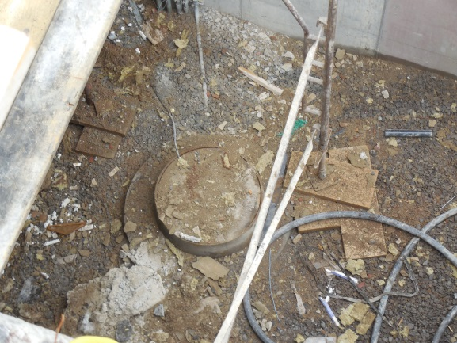
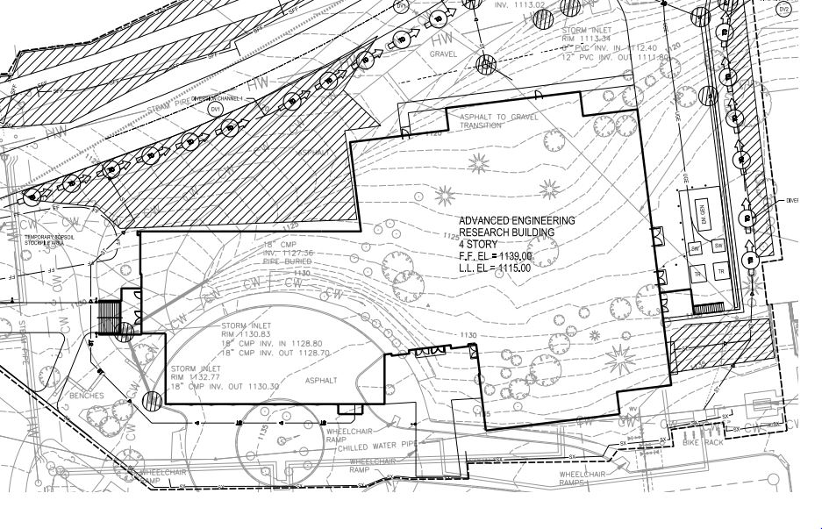
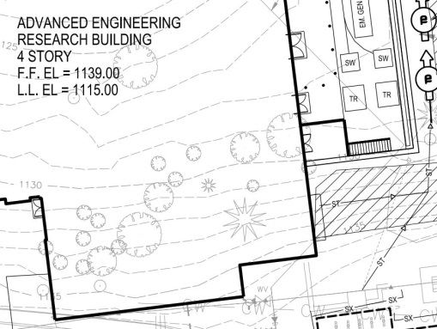
Project Overview
Jeremy Feath
Construction Option
Background
Analysis 3
Underground Spring
University Engineering Building
Mid-Atlantic University, United States
University Engineering Building
Mid-Atlantic University, United States
Project Overview
Analysis 1: Clean Room Coordination
Analysis 2: Roof System Redesign
Analysis 3: Underground Spring
Analysis 4: FM Information Delivery
Final Recommendations
Acknowledgements
Project Overview
Analysis 1: Clean Room Coordination
Background
Project Organization Results
Coordination Results
Analysis 2: Roof System Redesign
Background
Schedule Results
Cost Comparison
Structural Breadth
Analysis 3: Underground Spring
Background
Results
Mechanical Breadth
Analysis 4: FM Information Delivery
Final Recommendations
Acknowledgements
Problems:
Spring & Rain delayed construction during Excavation & Foundations
Spring was NOT discovered during GeoTech Investigation
Proposed Solution:
Addition of Waterproofing Membrane to Lab Foundation Wall w/ Sump Pump backup
Project Team Solution – Permanent Sump Pump
Sump Pump System Estimate
Material | Quantity | Unit | Cost per Unit | Total Cost
Sump Pump (Temporary) | 1 | EA | $120.00 | $120.00
Sump Pump (Permanent) | 1 | EA | $215.00 | $215.00
2" PVC | 160 | LF | $12.09 | $1,934.40
Check Valve | 1 | EA | $37.25 | $37.25
90° Elbow | 1 | EA | $46.86 | $46.86
45° Elbow | 3 | EA | $36.48 | $109.44
Total |  |  |  | $2,462.95
(Const. DWGs Courtesy of Stantec)
(Photos & Table Courtesy of Jeremy Feath)

Slide 24
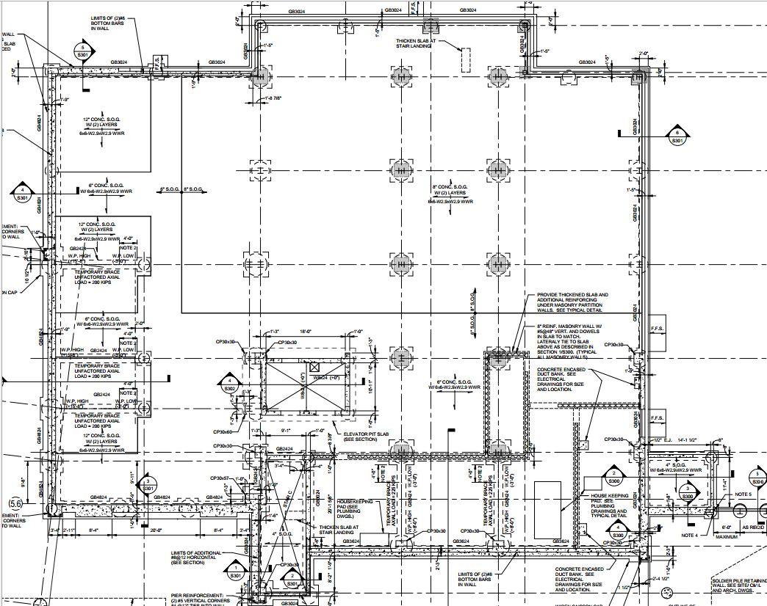
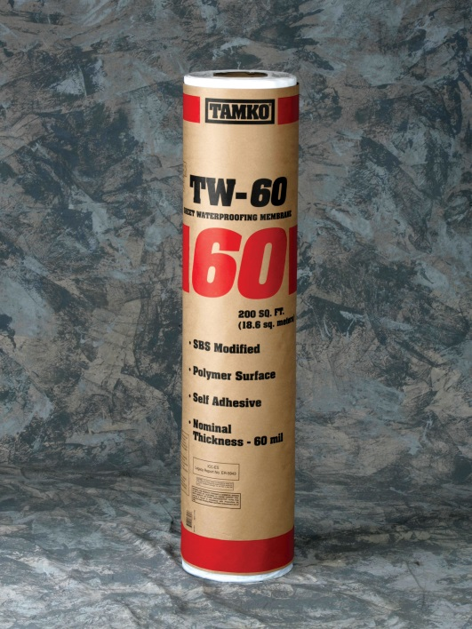
Project Overview
Jeremy Feath
Construction Option
Results
Analysis 3
Underground Spring
University Engineering Building
Mid-Atlantic University, United States
University Engineering Building
Mid-Atlantic University, United States
Project Overview
Analysis 1: Clean Room Coordination
Analysis 2: Roof System Redesign
Analysis 3: Underground Spring
Analysis 4: FM Information Delivery
Final Recommendations
Acknowledgements
Project Overview
Analysis 1: Clean Room Coordination
Background
Project Organization Results
Coordination Results
Analysis 2: Roof System Redesign
Background
Schedule Results
Cost Comparison
Structural Breadth
Analysis 3: Underground Spring
Background
Results
Mechanical Breadth
Analysis 4: FM Information Delivery
Final Recommendations
Acknowledgements
Underground Spring Solution:
Tamko TW-60 Waterproofing Membrane
N Line 1 – 6
6 Line N – G
G Line 1 – 6
1 Line G - N
(Const. DWGs Courtesy of Stantec)
(Photos & Table Courtesy of Jeremy Feath)
(Courtesy of Tamko)

Slide 25
Project Overview
Jeremy Feath
Construction Option
Results
Analysis 3
Underground Spring
University Engineering Building
Mid-Atlantic University, United States
University Engineering Building
Mid-Atlantic University, United States
Project Overview
Analysis 1: Clean Room Coordination
Analysis 2: Roof System Redesign
Analysis 3: Underground Spring
Analysis 4: FM Information Delivery
Final Recommendations
Acknowledgements
Project Overview
Analysis 1: Clean Room Coordination
Background
Project Organization Results
Coordination Results
Analysis 2: Roof System Redesign
Background
Schedule Results
Cost Comparison
Structural Breadth
Analysis 3: Underground Spring
Background
Results
Mechanical Breadth
Analysis 4: FM Information Delivery
Final Recommendations
Acknowledgements
Underground Spring Solution:
Tamko TW-60 Waterproofing Membrane
Cost Estimate Impact
Sump Pump System Estimate
Tamko TW-60 Material Foundation Wall Costs
Material | Quantity | Unit | Cost per Unit | Total Cost
Sump Pump (Temporary) | 1 | EA | $120.00 | $120.00
Sump Pump (Permanent) | 1 | EA | $215.00 | $215.00
2" PVC | 160 | LF | $12.09 | $1,934.40
Check Valve | 1 | EA | $37.25 | $37.25
90° Elbow | 1 | EA | $46.86 | $46.86
45° Elbow | 3 | EA | $36.48 | $109.44
Total |  |  |  | $2,462.95
Level 0 & Mezzanine (Lab) | Roll Width (in.) | Roll Size | Area Coverage | Wall Area | # Rolls Needed | Cost per Roll | Total Cost
N Line 1 - 6 | 39.375 | 39.375" x 61' | 200 | 3404.88 | 18 | $292.00 | $5,256.00
6 Line N - G | 39.375 | 39.375" x 61' | 200 | 4173.36 | 21 | $292.00 | $6,132.00
G Line 1 - 6 | 39.375 | 39.375" x 61' | 200 | 2496.96 | 13 | $292.00 | $3,796.00
1 Line G - N | 39.375 | 39.375" x 61' | 200 | 2210.18 | 12 | $292.00 | $3,504.00
Total |  |  |  |  |  |  | $18,688.00
N Line 1 – 6
6 Line N – G
G Line 1 – 6
1 Line G - N
Cost difference made up from Roof System change
System is necessary to combat the Spring in combination with heavy rainfall
Note: Labor Costs do NOT change
Total System Cost - $21,151.00
(Const. DWGs Courtesy of Stantec)
(Table s Courtesy of Jeremy Feath)
(Courtesy of Tamko)

Slide 26
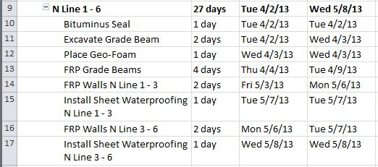
Project Overview
Jeremy Feath
Construction Option
Results
Analysis 3
Underground Spring
University Engineering Building
Mid-Atlantic University, United States
University Engineering Building
Mid-Atlantic University, United States
Project Overview
Analysis 1: Clean Room Coordination
Analysis 2: Roof System Redesign
Analysis 3: Underground Spring
Analysis 4: FM Information Delivery
Final Recommendations
Acknowledgements
Project Overview
Analysis 1: Clean Room Coordination
Background
Project Organization Results
Coordination Results
Analysis 2: Roof System Redesign
Background
Schedule Results
Cost Comparison
Structural Breadth
Analysis 3: Underground Spring
Background
Results
Mechanical Breadth
Analysis 4: FM Information Delivery
Final Recommendations
Acknowledgements
Underground Spring Solution:
Tamko TW-60 Waterproofing Membrane
Schedule Impact
Foundation Waterproofing Membrane Durations
Level 0 & Mezzanine (Lab) | LF Coverage | Wall Height | Daily Output (LF) | Daily Output (SF) | Coverage Area | Duration
N Line 1 - 6 | 141.87 | 24 | 80 | 1920 | 3404.88 | 1.77
6 Line N - G | 173.89 | 24 | 80 | 1920 | 4173.36 | 2.17
G Line 1 - 6 | 104.04 | 24 | 80 | 1920 | 2496.96 | 1.30
1 Line G - N | 157.87 | 14 | 80 | 1120 | 2210.18 | 1.97
Total |  |  |  |  |  | 7.22
N Line 1 – 6
6 Line N – G
G Line 1 – 6
1 Line G - N
Each Wall section follows same pattern
Duration from Table, broken down based on # of pours for the Wall section
Schedule increase acceptable, work can be completed around steel erection
Total Schedule Change = +4 days
Roughly 1 extra day per Wall section
(Const. DWGs Courtesy of Stantec)
(Table & Schedule Courtesy of Jeremy Feath)
(Courtesy of Tamko)

Slide 27
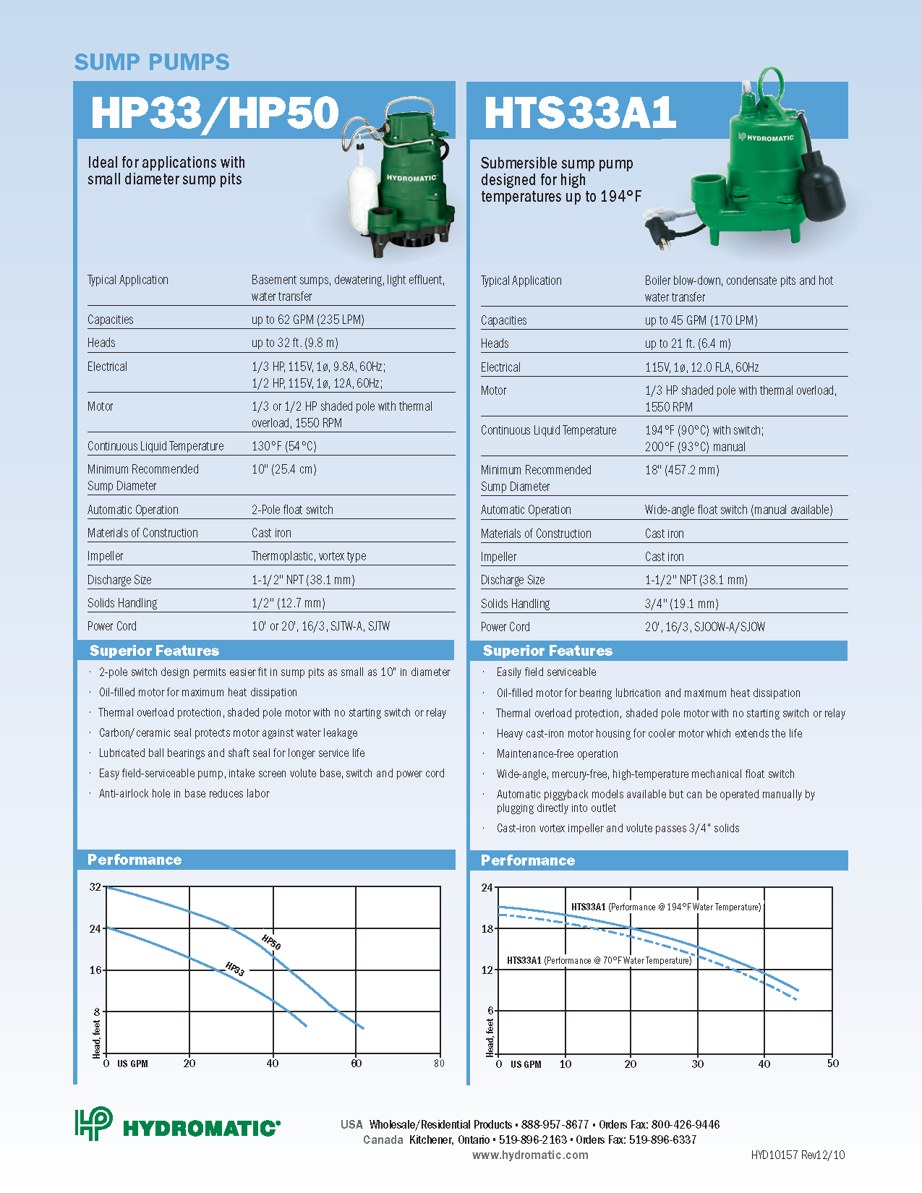
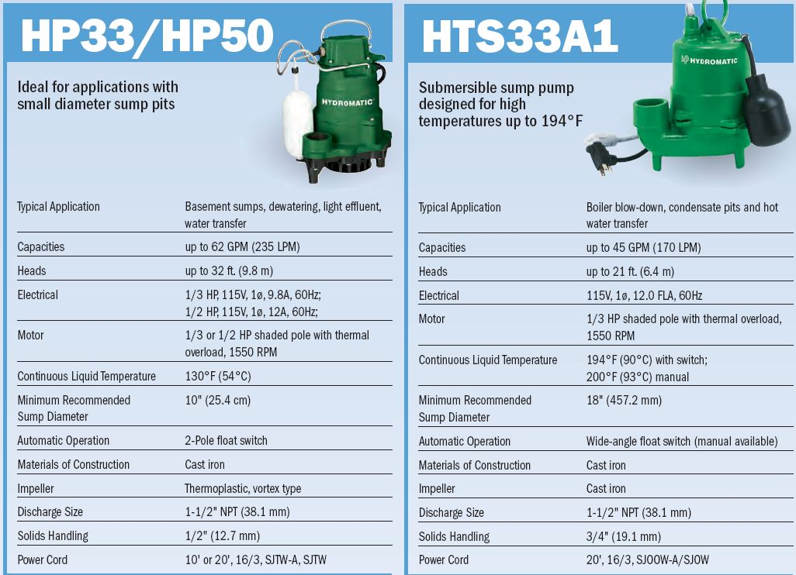
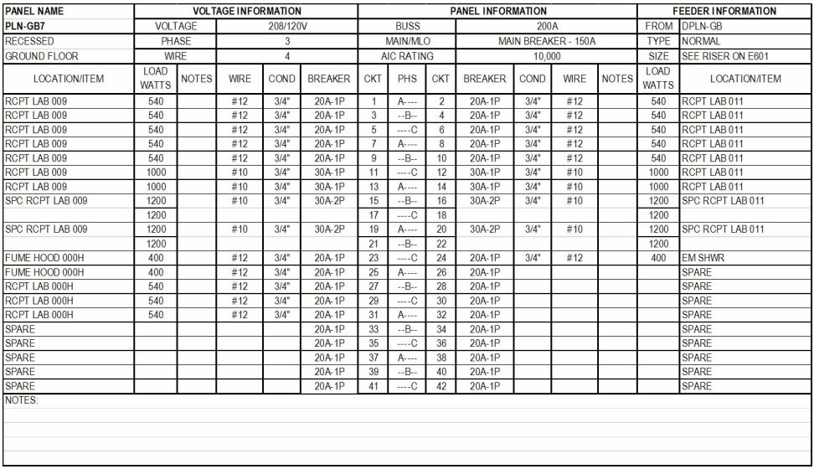
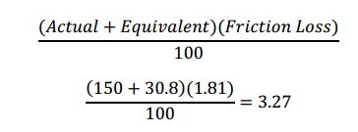
Project Overview
Jeremy Feath
Construction Option
Sizing of a Sump Pump
Analysis 3
Underground Spring
University Engineering Building
Mid-Atlantic University, United States
University Engineering Building
Mid-Atlantic University, United States
Project Overview
Analysis 1: Clean Room Coordination
Analysis 2: Roof System Redesign
Analysis 3: Underground Spring
Analysis 4: FM Information Delivery
Final Recommendations
Acknowledgements
Project Overview
Analysis 1: Clean Room Coordination
Background
Project Organization Results
Coordination Results
Analysis 2: Roof System Redesign
Background
Schedule Results
Cost Comparison
Structural Breadth
Analysis 3: Underground Spring
Background
Results
Mechanical Breadth
Analysis 4: FM Information Delivery
Final Recommendations
Acknowledgements
Technical Data:
System Capacity = 30 GPM
Total Dynamic Head = 14’
Static Head = 10’
Friction Head = 3.27’
Level 0 Panelboards have the capacity to handle the additional load of a sump pump
(Const. DWGs Courtesy of Stantec)
(Equation Courtesy of Jeremy Feath) (Literature Courtesy of Hydromatic)

Slide 28
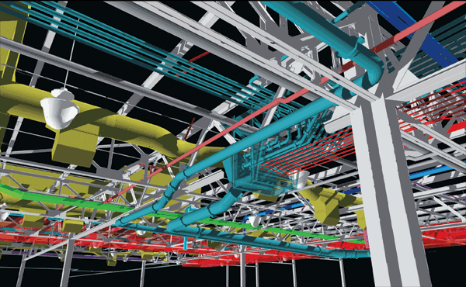
Analysis 4
CM to FM Information Delivery
Project Overview
Jeremy Feath
Construction Option
Summary
University Engineering Building
Mid-Atlantic University, United States
University Engineering Building
Mid-Atlantic University, United States
Project Overview
Analysis 1: Clean Room Coordination
Analysis 2: Roof System Redesign
Analysis 3: Underground Spring
Analysis 4: FM Information Delivery
Final Recommendations
Acknowledgements
Project Overview
Analysis 1: Clean Room Coordination
Background
Project Organization Results
Coordination Results
Analysis 2: Roof System Redesign
Background
Schedule Results
Cost Comparison
Structural Breadth
Analysis 3: Underground Spring
Background
Results
Mechanical Breadth
Analysis 4: FM Information Delivery
Final Recommendations
Acknowledgements
Key Takeaways:
Necessary to weed out critical information from excess
It’s not always the information itself, but the means of using that information for O&M
(Images Courtesy of Google, Penn State & IBM)

Slide 29
Project Overview
Jeremy Feath
Construction Option
Final Recommendations
Jeremy Feath
Construction Option
University Engineering Building
Mid-Atlantic University, United States
University Engineering Building
Mid-Atlantic University, United States
Project Overview
Analysis 1: Clean Room Coordination
Analysis 2: Roof System Redesign
Analysis 3: Underground Spring
Analysis 4: FM Information Delivery
Final Recommendations
Acknowledgements
Project Overview
Analysis 1: Clean Room Coordination
Background
Project Organization Results
Coordination Results
Analysis 2: Roof System Redesign
Background
Schedule Results
Cost Comparison
Structural Breadth
Analysis 3: Underground Spring
Background
Results
Mechanical Breadth
Analysis 4: FM Information Delivery
Final Recommendations
Acknowledgements
Analysis 1: Clean Room Coordination:
Reorganize project team chart to reflect new contractual obligations for Hodess
Creation of Coordination Schedule to maximize early coordination for the Clean Room
Recommendation: PROCEED
Analysis 3: Underground Spring:
Add Waterproofing Membrane in addition to the sump pump solution of the project team.
Schedule Impact is negligible
Cost Impact, while substantial, can be offset by Roof savings
Recommendation: PROCEED
Analysis 2: Roof System Redesign:
Replace Fully-Adhered TPO with InvisiWeld TPO system.
Saves 20+ working days on schedule
Saves $27,000 in costs
Recommendation: PROCEED
Analysis 4: CM – FM Information Delivery:
Outline created to help Owners/FM incorporate technologies
Means of using information more important than information at times
Recommendation: PROCEED
(Courtesy of Owner)

Slide 30
Project Overview
Jeremy Feath
Construction Option
Acknowledgements
Jeremy Feath
Construction Option
University Engineering Building
Mid-Atlantic University, United States
University Engineering Building
Mid-Atlantic University, United States
Project Overview
Analysis 1: Clean Room Coordination
Analysis 2: Roof System Redesign
Analysis 3: Underground Spring
Analysis 4: FM Information Delivery
Final Recommendations
Acknowledgements
Project Overview
Analysis 1: Clean Room Coordination
Background
Project Organization Results
Coordination Results
Analysis 2: Roof System Redesign
Background
Schedule Results
Cost Comparison
Structural Breadth
Analysis 3: Underground Spring
Background
Results
Mechanical Breadth
Analysis 4: FM Information Delivery
Final Recommendations
Acknowledgements
A Special Thanks to …
AE Faculty & Staff
Dr. Craig Dubler
Dr. Ed Gannon
Todd Bookwalter
Bud Curry
The University Project Team
Massaro Project Team
Friends & Family
(Courtesy of Stantec)

Slide 31
Project Overview
Jeremy Feath
Construction Option
Questions
Jeremy Feath
Construction Option
University Engineering Building
Mid-Atlantic University, United States
University Engineering Building
Mid-Atlantic University, United States
Project Overview
Analysis 1: Clean Room Coordination
Analysis 2: Roof System Redesign
Analysis 3: Underground Spring
Analysis 4: FM Information Delivery
Final Recommendations
Acknowledgements
Project Overview
Analysis 1: Clean Room Coordination
Background
Project Organization Results
Coordination Results
Analysis 2: Roof System Redesign
Background
Schedule Results
Cost Comparison
Structural Breadth
Analysis 3: Underground Spring
Background
Results
Mechanical Breadth
Analysis 4: FM Information Delivery
Final Recommendations
Acknowledgements
Analysis 1: Clean Room Coordination:
Reorganize project team chart to reflect new contractual obligations for Hodess
Creation of Coordination Schedule to maximize early coordination for the Clean Room
Recommendation: PROCEED
Analysis 3: Underground Spring:
Add Waterproofing Membrane in addition to the sump pump solution of the project team.
Schedule Impact is negligible
Cost Impact, while substantial, can be offset by Roof savings
Recommendation: PROCEED
Analysis 2: Roof System Redesign:
Replace Fully-Adhered TPO with InvisiWeld TPO system.
Saves 20+ working days on schedule
Saves $27,000 in costs
Recommendation: PROCEED
Analysis 4: CM – FM Information Delivery:
Outline created to help Owners/FM incorporate technologies
Means of using information more important than information at times
Recommendation: PROCEED
(Courtesy of Owner)

